Slide 1
Learning Objective
I will be able to review conditional probability and independent events
Success Criteria
At the end of the lesson sequence, I will be able to:
3.3.1 Develop the concepts of a discrete random variable and its associated probability function, and their use in modelling data
3.3.2 Use relative frequencies obtained from data to obtain point estimates of probabilities associated with a discrete random variable

Slide 2

Activating Prior Knowledge
Conditional Probability
The probability of A given B is written as
$$P\left(A|B\right)=\frac{P\left(A∩B\right)}{P\left(B\right)}$$

Slide 3
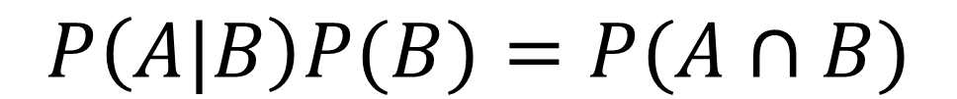
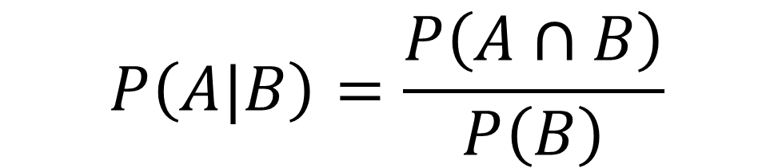
Activating Prior Knowledge
Law of total probability
$$P\left(A\right)=P\left(A | B\right)P\left(B\right)+P\left(A | B^{′}\right)P(B′)$$
$$P\left(A|B\right)=\frac{P\left(A∩B\right)}{P\left(B\right)}$$
$$P\left(A|B\right)P(B)=P(A∩B)$$
$$P\left(A\right)=P(A∩B)+P(A∩B′)$$

Slide 4
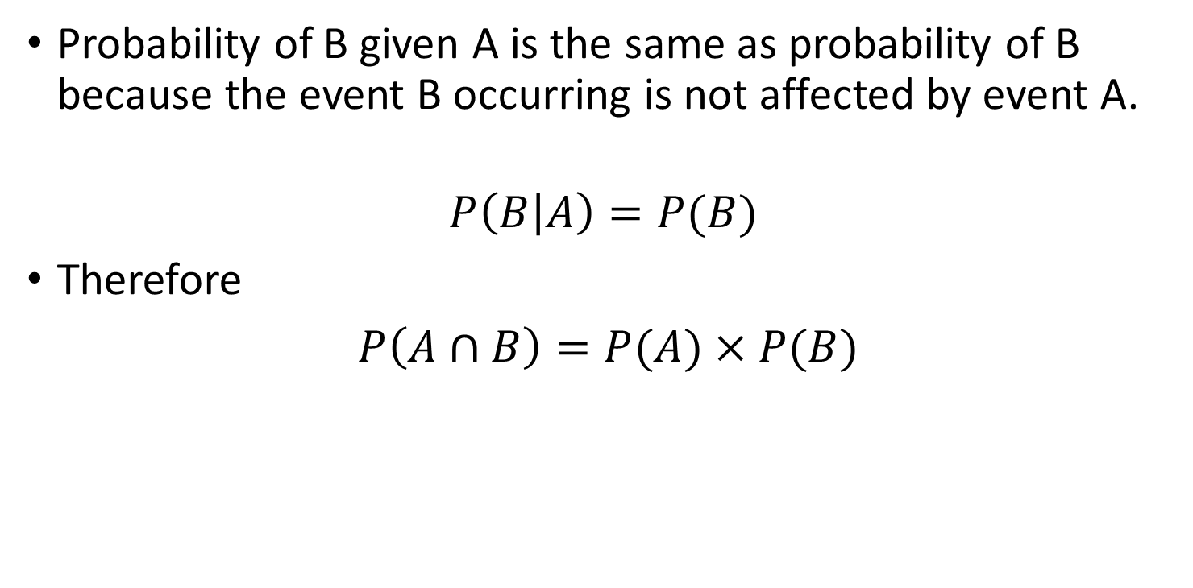
For any 2 independent events A & B
Activating Prior Knowledge
Probability of B given A is the same as probability of B because the event B occurring is not affected by event A.
$$P\left(B | A\right)=P(B)$$
Therefore
$P\left(A∩B\right)=P(A)×P(B)$

Slide 5
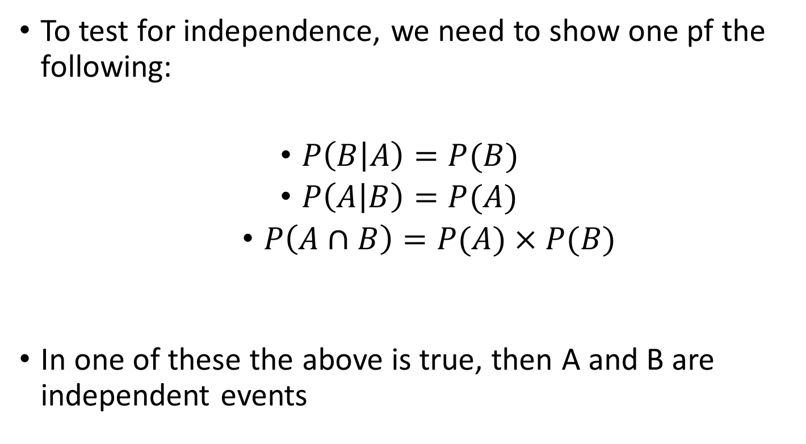
Test for independence
Activating Prior Knowledge
To test for independence, we need to show one pf the following:
$P\left(B | A\right)=P(B)$
$P\left(A | B\right)=P(A)$
$P\left(A∩B\right)=P(A)×P(B)$
In one of these the above is true, then A and B are independent events

Slide 6


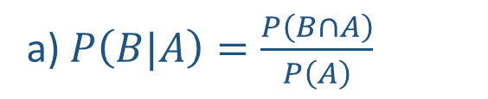

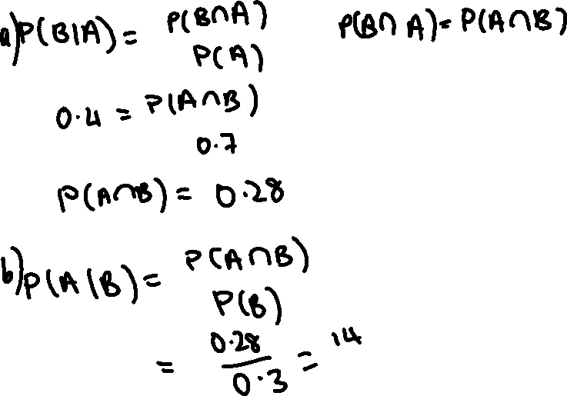

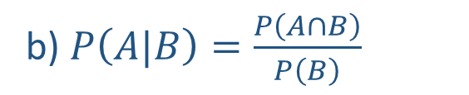

Guided Practice
a) $P\left(B|A\right)=\frac{P\left(B∩A\right)}{P\left(A\right)}$
$$0.4=\frac{P\left(B∩A\right)}{0.7}$$
$$P\left(A∩B\right)=0.28$$
b) $P\left(A|B\right)=\frac{P\left(A∩B\right)}{P\left(B\right)}$
$$=\frac{0.28}{0.3}$$
$$=\frac{28}{30}$$
$$=\frac{14}{15}$$

Slide 7
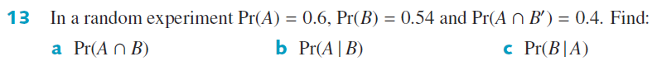
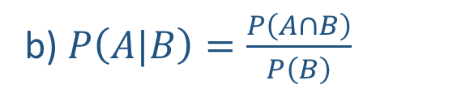


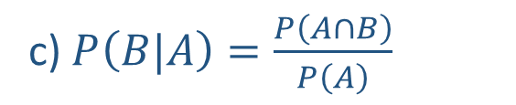

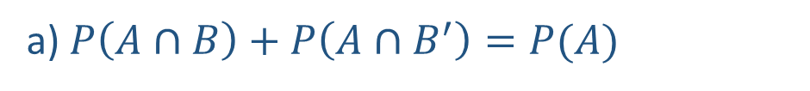



Guided Practice
a) $P\left(A∩B\right)+P\left(A∩B^{′}\right)=P(A)$
c) $P\left(B|A\right)=\frac{P\left(A∩B\right)}{P\left(A\right)}$
$P\left(A∩B\right)+0.4=0.6$
$$=\frac{0.2}{0.6}$$
$P\left(A∩B\right)=0.2$
$$=\frac{1}{3}$$
b) $P\left(A|B\right)=\frac{P\left(A∩B\right)}{P\left(B\right)}$
$$=\frac{0.2}{0.54}$$
$$=\frac{20}{54}$$
$$=\frac{10}{27}$$

Slide 8
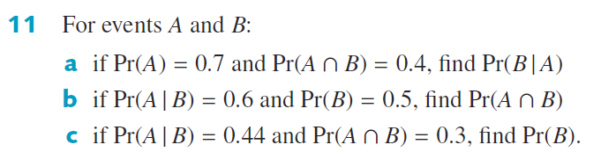


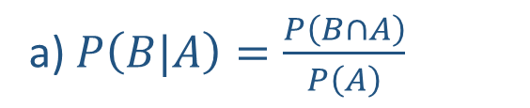
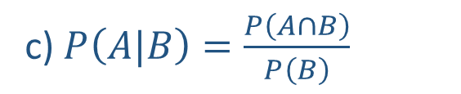


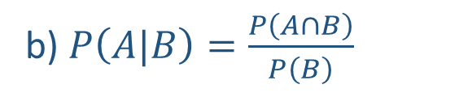
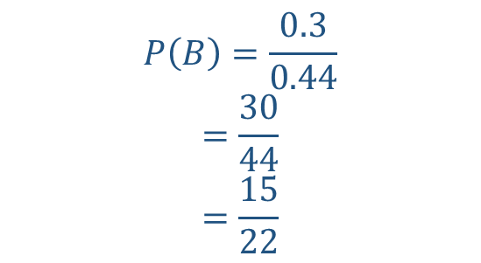
Guided Practice
a) $P\left(B|A\right)=\frac{P\left(B∩A\right)}{P\left(A\right)}$
c) $P\left(A|B\right)=\frac{P\left(A∩B\right)}{P\left(B\right)}$
$$=\frac{0.4}{0.7}=\frac{4}{7}$$
$$0.44=\frac{0.3}{P(B)}$$
b) $P\left(A|B\right)=\frac{P\left(A∩B\right)}{P\left(B\right)}$
$$P\left(B\right)=\frac{0.3}{0.44}$$
$$=\frac{30}{44}$$
$$=\frac{15}{22}$$
$$0.6=\frac{P\left(A∩B\right)}{0.5}$$
$$P\left(A∩B\right)=0.6×0.5=0.3$$

Slide 9
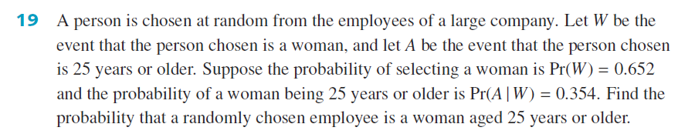




Guided Practice
$P\left(A|W\right)=\frac{P\left(A∩W\right)}{P\left(W\right)}$
$$0.354=\frac{P\left(A∩W\right)}{0.652}$$
$$P\left(A∩W\right)=0.354×0.652$$
$$=0.231$$

Slide 10

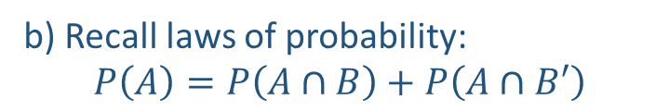



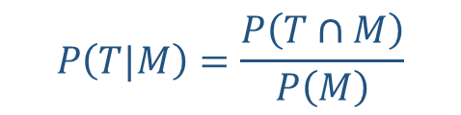

Guided Practice
In a certain town, the probability that it rains on any Monday is 0.21. If it rains on Monday, then the probability that it rains on Tuesday is 0.83. If it does not rain on Monday, then the probability of rain on Tuesday is 0.3. For a given week, find the probability that it rains:
On both Monday and Tuesday
On Tuesday
b) Recall laws of probability:
$$P\left(A\right)=P\left(A∩B\right)+P\left(A∩B′\right)$$
$P\left(M\right)=0.21$
$P\left(T|M\right)=0.83$
$$P\left(T\right)=P\left(T∩M\right)+P\left(T∩M′\right)$$
$P\left(M′\right)=1−0.21=0.79$
$$P\left(T\right)=P\left(T|M\right)P\left(M\right)+P\left(T|M′\right)P\left(M′\right)$$
$$P\left(T|M′\right)=0.3$$
$$P\left(T\right)=0.1743+0.3×0.79$$
$$P\left(T|M\right)=\frac{P\left(T∩M\right)}{P\left(M\right)}$$
$$P\left(T\right)=0.4113$$
a) $P\left(T∩M\right)=P\left(T|M\right)P\left(M\right)$
$$P\left(T∩M\right)=0.83×0.21=0.1743$$

Slide 11




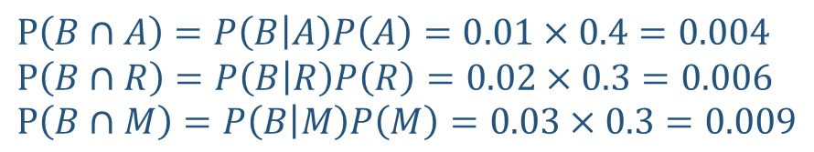
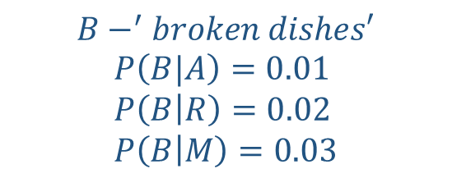

Guided Practice
Adrienne, Regan and Michael are doing the dishes. Since Adrienne is the oldest, she washes the dishes 40% of the time. Regan and Michael each wash 30% of the time. When Adrienne washes the probability of at least one dish being broken is 0.01, when Regan washes the probability is 0.02, and when Michael washes the probability is 0.03. Their parents don’t know who is washing the dishes one particular night.
What is the probability that at least one dish will be broken?
Given that at least one dish is broken, what is the probability that the person washing was Michael?
$$A−^{′}Adrienne washes the dishes′$$
$$P\left(A\right)=0.4$$
$$P\left(B∩A\right)=P\left(B | A\right)P\left(A\right)=0.01×0.4=0.004 \\ P\left(B∩R\right)=P\left(B | R\right)P\left(R\right)=0.02×0.3=0.006 \\ P\left(B∩M\right)=P\left(B | M\right)P\left(M\right)=0.03×0.3=0.009$$
$$R−^{′}Regan washes the dishes′$$
$$P\left(R\right)=0.3$$
$$M−^{′}Michael washes the dishes′$$
$$P\left(M\right)=0.3$$
$$P\left(B\right)=P\left(B∩A\right)+P\left(B∩R\right)+P(B∩M)$$
$$P\left(B\right)=0.04+0.06+0.09=0.019$$
$$B−^{′}broken dishes′$$
$$P\left(B|A\right)=0.01 \\ P\left(B | R\right)=0.02 \\ P\left(B | M\right)=0.03$$
$$P\left(M|B\right)=\frac{P\left(M∩B\right)}{P\left(B\right)}$$
$$=\frac{0.009}{0.019}=\frac{9}{19}$$

Slide 12
Independent Practice
Complete Cambridge Ex 8B

